Slide 1

Today’s Agenda
State reduction
Design of seuquencial circuit using D- flip flops

Slide 2
State Reduction:
Analysis:
  Circuit diagram → Boolean Expressions → State Table → State Diagram
Design (Synthesis):
  Specifications → State Diagram → State Table →
  Boolean Expressions → Circuit Diagram
Redundant/ Equivalent State:
  Redundant state may exist in state table or diagram.
  By eliminating the redundant state, we can reduce number of logic gates and flip flops.
Suppose:
  I/O sequences are important
  The internal states are used merely to provide the required sequences
Algorithm:

Slide 3
State Reduction - Algorithm
When two states are equivalent, one of them can
be removed without altering the input–output relationships
Two states are said to be equivalent if, for each member of the set of inputs, they give exactly the same output and send the circuit either to the
same state or to an equivalent state

Slide 4
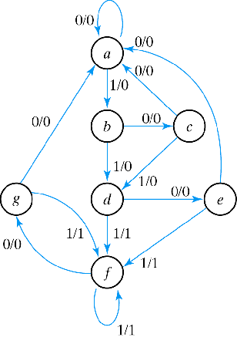
Example-1(Row Matcing)
State Transition Table
NS output
PS x=0 x=1 x=0 x=1
a a b 0 0
b c d 0 0
c a d 0 0
d e f 0 1
e a f 0 1
f g f 0 1
g a f 0 1

Slide 5
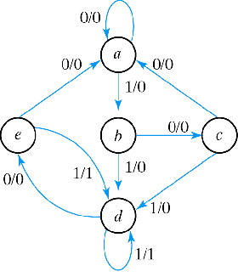
Example-1
NS output
PS x=0 x=1 x=0 x=1
a a b 0 0
b c d 0 0
c a d 0 0
d e f 0 1
e a f 0 1
f e f 0 1
Reduced State Transition Diagram
NS output
PS x=0 x=1 x=0 x=1
a a b 0 0
b c d 0 0
c a d 0 0
d e d 0 1
e a d 0 1

Slide 6
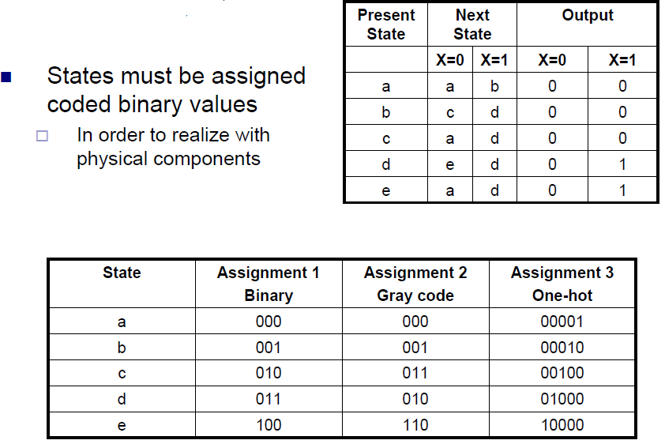
State Assignment:

Slide 7
Sequential Circuits– Design Procedure
Procedure
Draw state transition diagram
Make state table
Reduced state table (if possible)
Choose flip-flop type
Derive simplified flip-flop input equations and output equations
Draw the logic diagram

Slide 8
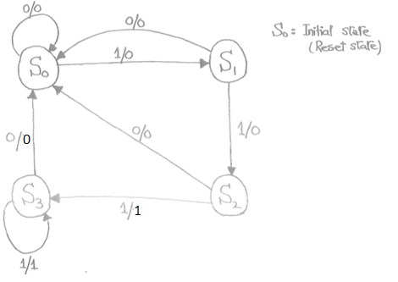
Synthesis using D flip flop:
Example: Detect 3 or more consecutive 1’s
State | A B
S₀ | 0 0
S₁ | 0 1
S₂ | 1 0
S₃ | 1 1

Slide 9
Example: Detect 3 or more consecutive 1’s
0
1
S₀ / 0
S₁ / 0
0
State | A B
S₀ | 0 0
S₁ | 0 1
S₂ | 1 0
S₃ | 1 1
0
1
0
S₃ / 1
S₂ / 0
1
1

Slide 10
Example: Detect 3 or more consecutive 1’s
Present State |  | Input | Next State |  | Output
A | B | x | A | B | y
0 | 0 | 0
0 | 0 | 1
0 | 1 | 0
0 | 1 | 1
1 | 0 | 0
1 | 0 | 1
1 | 1 | 0
1 | 1 | 1
0
1
0 0 0
0 1 0
0 0 0
1 0 0
0 0 0
1 1 0
0 0 1
1 1 1
S₀ / 0
S₁ / 0
0
0
1
0
S₃ / 1
S₂ / 0
1
1

Slide 11
Example: Detect 3 or more consecutive 1’s
Present State |  | Input | Next State |  | Output
A | B | x | A | B | y
0 | 0 | 0
0 | 0 | 1
0 | 1 | 0
0 | 1 | 1
1 | 0 | 0
1 | 0 | 1
1 | 1 | 0
1 | 1 | 1
Synthesis using D Flip-Flops
0 0 0
0 1 0
0 0 0
1 0 0
0 0 0
1 1 0
0 0 1
1 1 1
A(t+1) = D_{A} (A, B, x)
= ∑ (3, 5, 7)
B(t+1) = D_{B} (A, B, x)
= ∑ (1, 5, 7)
y (A, B, x) = ∑ (6, 7)

Slide 12
Example: Detect 3 or more consecutive 1’s
Synthesis using D Flip-Flops
 |  |  |  | B
 |  | 0 | 0 | 1 | 0
A |  | 0 | 1 | 1 | 0
 |  |  | x
D_{A} (A, B, x) = ∑ (3, 5, 7)
= A x + B x
D_{B} (A, B, x) = ∑ (1, 5, 7)
= A x + B’ x
y (A, B, x) = ∑ (6, 7)
= A B
 |  |  |  | B
 |  | 0 | 1 | 0 | 0
A |  | 0 | 1 | 1 | 0
 |  |  | x
 |  |  |  | B
 |  | 0 | 0 | 0 | 0
A |  | 0 | 0 | 1 | 1
 |  |  | x

Slide 13
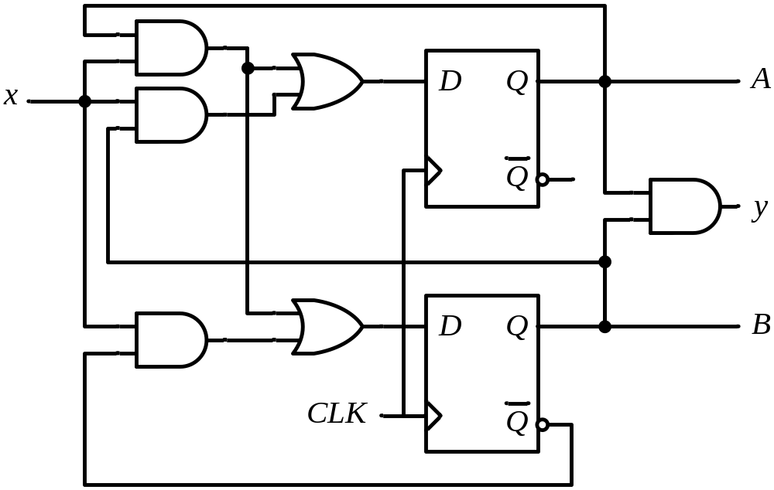
Example: Detect 3 or more consecutive 1’s
Synthesis using D Flip-Flops
D_{A} = A x + B x
D_{B} = A x + B’ x
y = A B

Slide 14
Practice Problems
5.12,5.13,5.16

